Slide 1
GLUCOSENSE
(AI-POWERED DIABETES DETECTION
FOR EARLY INVENTION )
MENTOR - Mr.Ravi
Presenters Name: Thota Rahul

Slide 2



PRESENTATION BY
Thota Rahul
Chede Rethasvi
Shantanu Punwatkar

Slide 3


PROBLEM STATEMENT
Diabetes is a growing global health issue, with cases rising significantly over the past 15 years due to lifestyle factors.
Early detection can prevent complications and improve health outcomes.
Objective:
To develop an AI-powered model that predicts a person’s diabetes status (Healthy, Pre-Diabetic, or Diabetic) using healthcare and lifestyle data

Slide 4
STEPS INVOLVED
Data Collection: Gather healthcare and lifestyle survey statistics
EDA & Preprocessing: Explore data, handle missing values, and normalize
Feature Selection: Identify important features, apply reduction techniques
Build Model: Train and test classification models
Evaluation Metrics: Use Accuracy, Precision, Recall, and F1-Score

Slide 5
DATASET OVERVIEW
Records: 520 rows | Features: 17 (16 input, 1 output)
Purpose: Predict diabetes from healthcare & lifestyle data
Key Features:
Age: Numerical
Gender: Male/Female
Symptoms: Polyuria, Polydipsia, etc. (Binary)
Lifestyle Factors: Obesity, Alopecia, Muscle Stiffness, etc. (Binary)
Data Insights:
Class Distribution: Likely imbalanced (more non-diabetic cases)
Data Quality: No missing values; binary features except Age

Slide 6
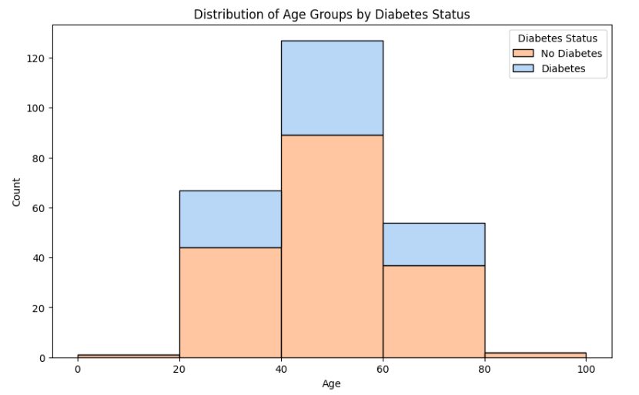
EXPLORATORY DATA ANALYSIS
Purpose: Highlight the patterns, trends, and distributions in the data.
Univariate Analysis: Distribution of Age, Gender, and other features using histograms.
Bivariate Analysis: Correlation between features (e.g., Age vs. Class) using scatter plots or heatmaps.
Outliers: Visuals showing box plots for features like Age.
Class Distribution: Bar chart showing the ratio of diabetic vs. non-diabetic samples.
Visuals: Heatmap for correlation analysis, Boxplots for visualizing outliers in features like Age, Histograms to show the distribution of key features like Age

Slide 7
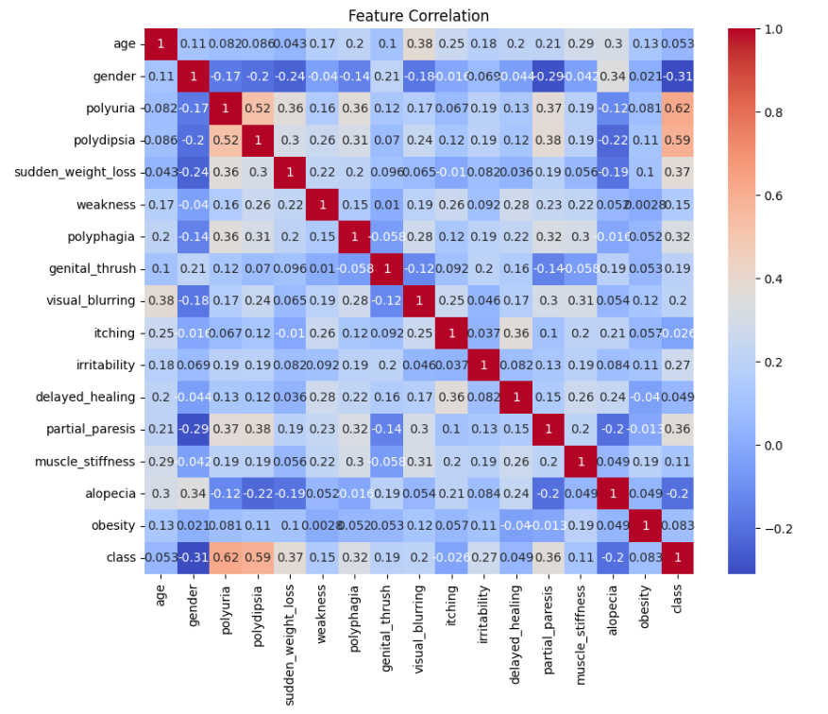
FEATURE SELECTION
Key Observations from the Correlation Matrix: Strong Correlation with Class (Target): Polyuria (0.62) and Polydipsia (0.59) are strong indicators of diabetes.
Moderate Correlation Among Symptoms: Polyuria and Polydipsia (0.52) often occur together. Weakness and Sudden Weight Loss (0.36) show a moderate relationship.
Low or No Correlation: Alopecia, Genital Thrush, and Muscle Stiffness have low predictive power for diabetes.
Age: Age has very low correlation with most symptoms and may not strongly predict diabetes in this dataset

Slide 8
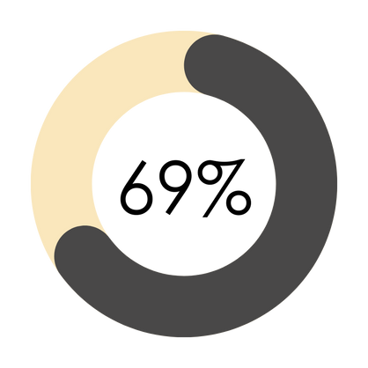
TARGET VARIABLE
69% of individuals in the dataset are diagnosed with diabetes
31% of individuals in the dataset do not have diabetes

Slide 9

CLASSIFICATION MODELS
Logistic Regression (LR): Linear model, predicts probabilities using the logistic function.
Support Vector Machine (SVM): Uses hyperplanes, effective for high-dimensional data.
Random Forest (RF): Ensemble of decision trees, reduces overfitting.
Decision Tree (DT): Simple, interpretable, splits data by features.
Extra Trees (ET): Random splits, improves variance reduction.
Gradient Boosting (GB): Sequential models to minimize error.
XGBoost (XGB): Efficient, scalable Gradient Boosting variant

Slide 10
METRICS AFTER MODELLLING
Model | Accuracy | Precision | Recall | F1-Score
Logistic Regression | 0.823529 | 0.825000 | 0.942857 | 0.880000
Decision Tree | 0.882353 | 0.891892 | 0.942857 | 0.916667
Support Vector Machine | 0.901961 | 0.894737 | 0.971429 | 0.931507
Random Forest | 0.921569 | 0.918919 | 0.971429 | 0.944444
Gradient Boosting | 0.901961 | 0.894737 | 0.971429 | 0.931507
Extra Trees | 0.921569 | 0.918919 | 0.971429 | 0.944444
XGBoost | 0.882353 | 0.891892 | 0.942857 | 0.916667

Slide 11
METRICS AFTER HYPERPARAMETER TUNING
Model | Accuracy | Precision | Recall | F1-Score
Logistic Regression | 0.862745 | 0.850000 | 0.971429 | 0.906667
Decision Tree | 0.882353 | 0.891892 | 0.942857 | 0.916667
Support Vector Machine | 0.882353 | 0.871795 | 0.971429 | 0.918919
Random Forest | 0.901961 | 0.916667 | 0.942857 | 0.929577
Gradient Boosting | 0.862745 | 0.888889 | 0.914286 | 0.901408
Extra Trees | 0.921569 | 0.918919 | 0.971429 | 0.944444
XGBoost | 0.901961 | 0.894737 | 0.971429 | 0.931507

Slide 12
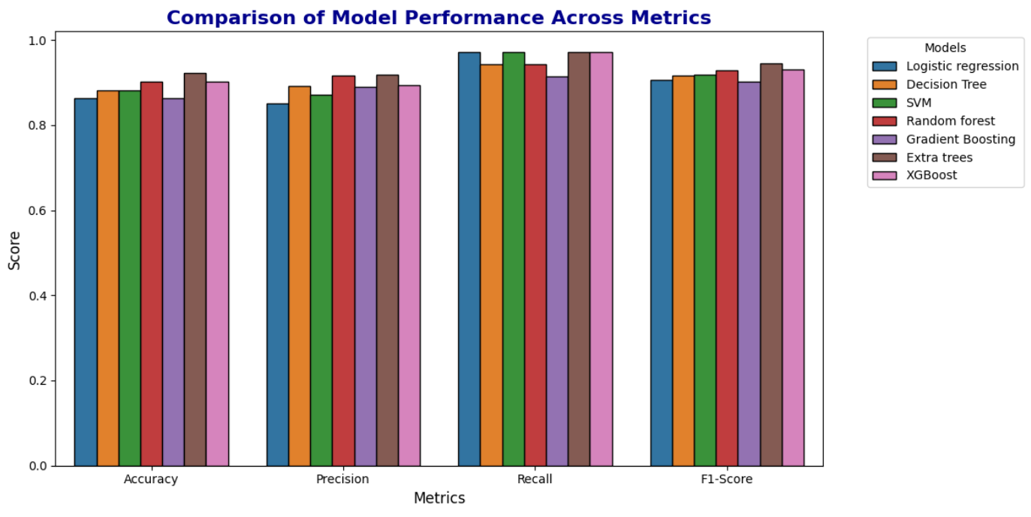
METRICS COMPARISON

Slide 13
CHOOSING THE BEST MODEL
Best Model: Extra Trees
Why Extra Trees?
- Highest Accuracy: 92.16%
- High Precision: 91.89% (fewer false positives)
- Excellent Recall: 97.14% (captures most positives)
- Best F1-Score: 94.44%
Close Contenders: Random Forest and XGBoost (slightly lower metrics).

Slide 14
THANK YOU!

